Slide 1
CEIS101 Module 1
Inventory and Organization

Slide 2
Rubric
Activity | Requirement(s) | Points
Inventory of IoT Bundle | Picture of required inventory of components. | 15
Organization of components from IoT Bundle | Picture of required organization of components. | 15

Slide 3
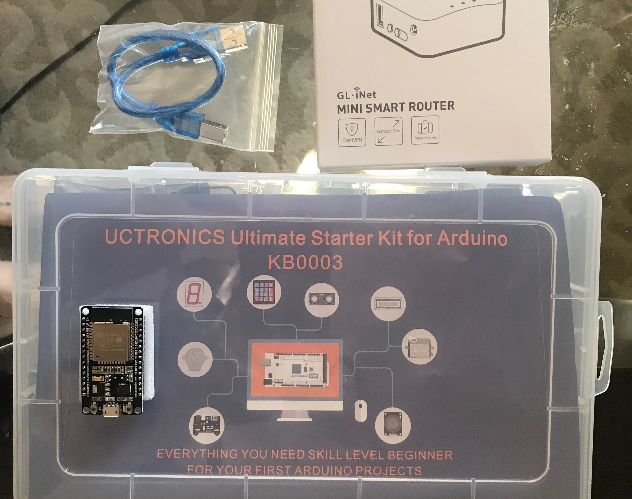
Inventory (Picture)
Arduino Starter Kit
Mini-Smart Router
USB-microUSB Cable
Esp32 Board

Slide 4
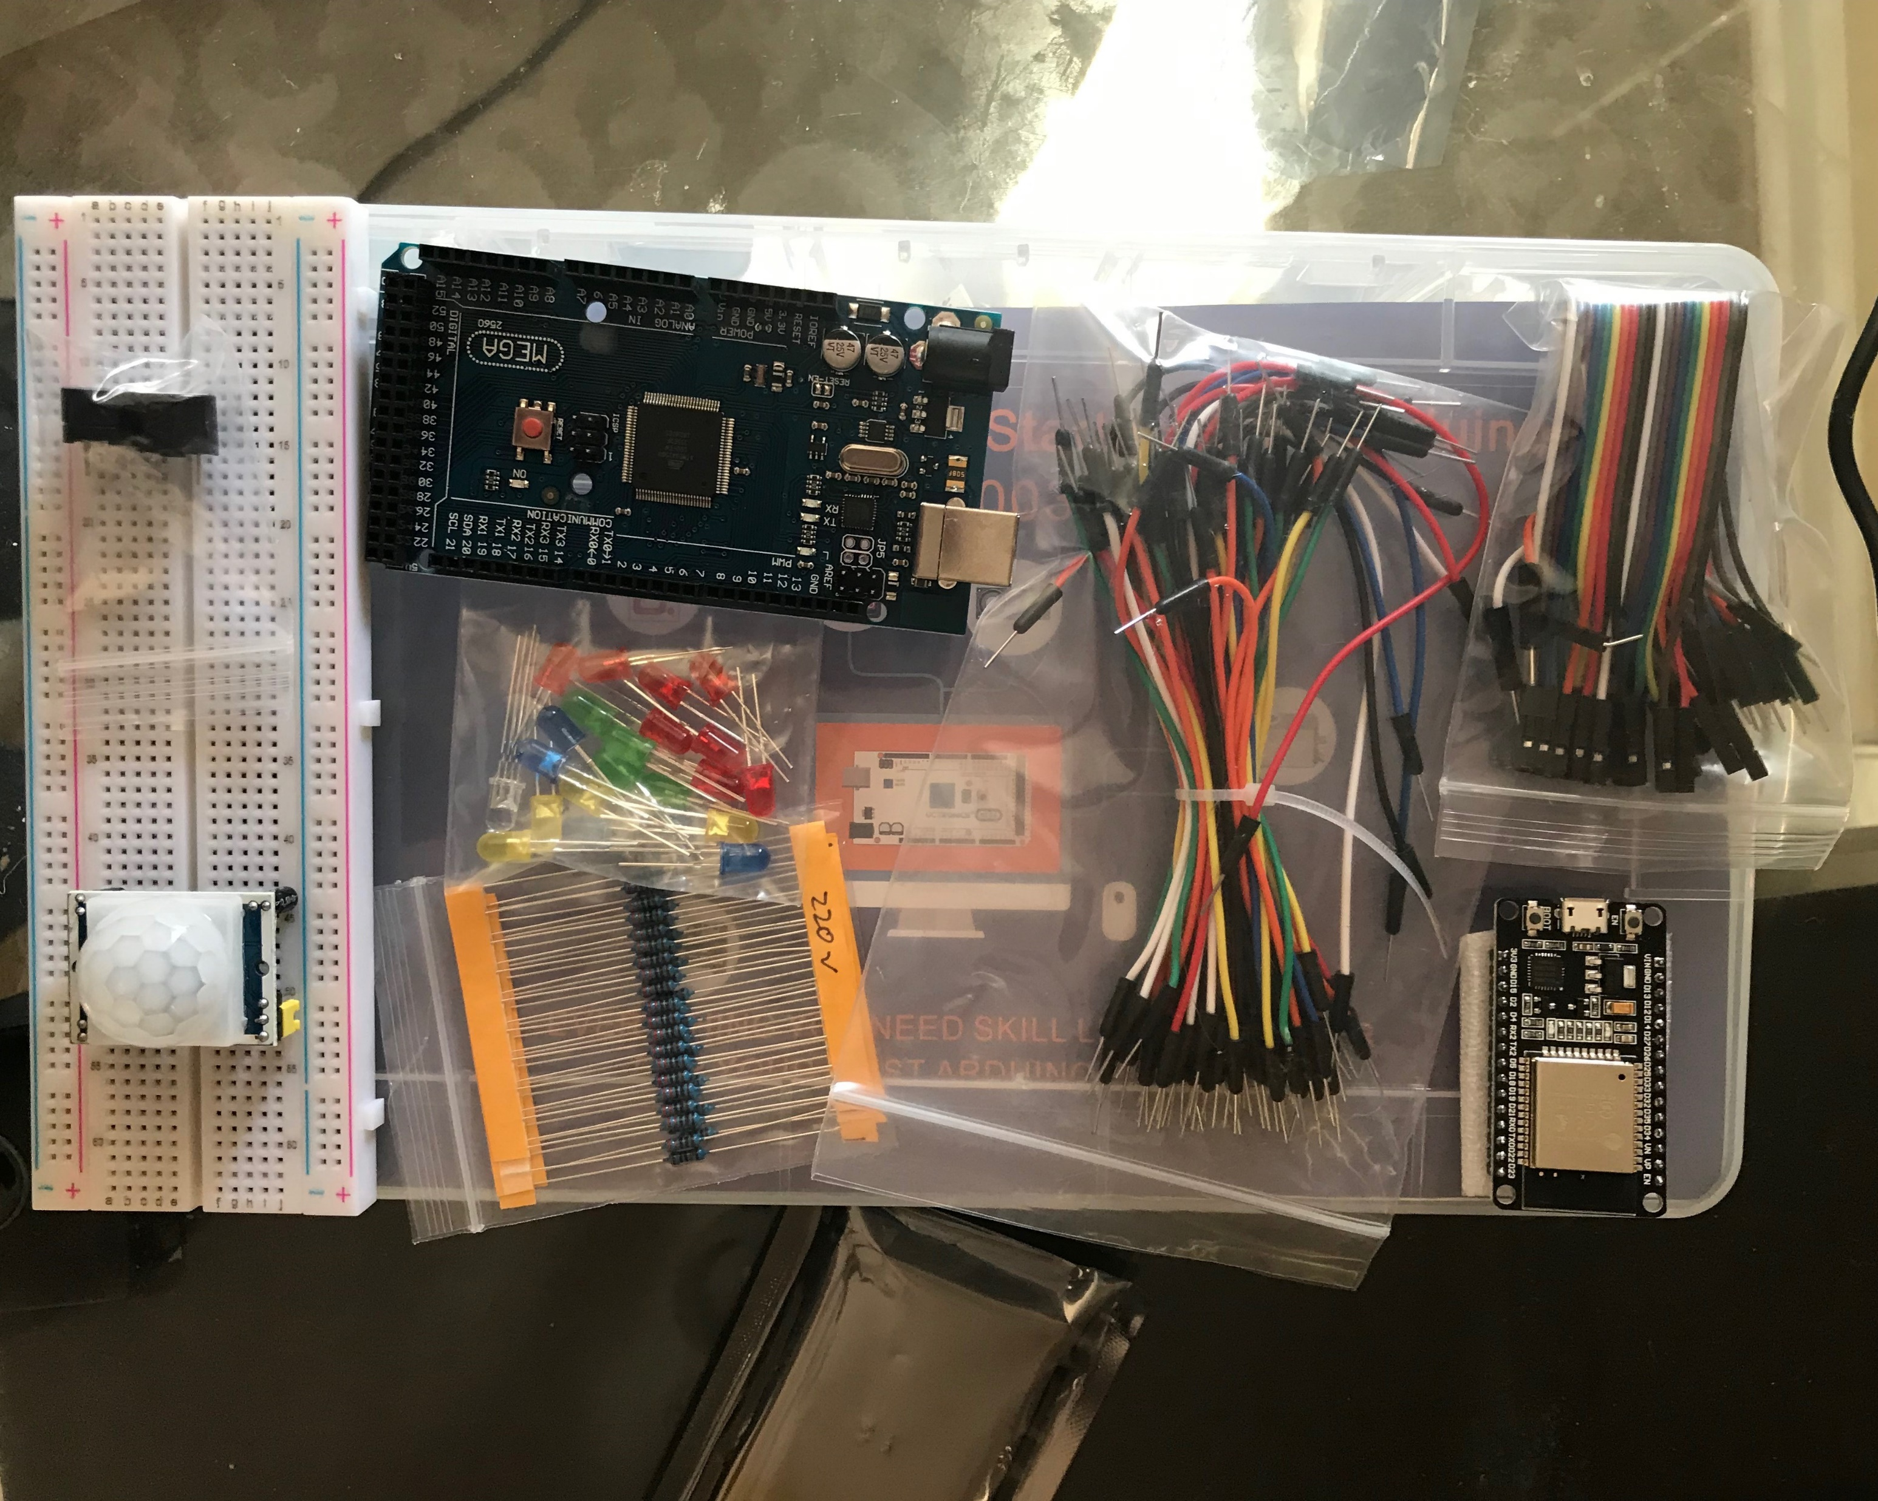
Organization (Picture)
Arduino Megaboard
Resistor - 220Ω
LED
Breadboard
Motion Sensor
Wire(s)
Buzzer
Esp32 Board

